Slide 1
CS2422 Assembly Language & System Programming
December 16, 2003

Slide 2
Today’s Topics
Machine-Independent Loader Features
  Automatic Library Search
  Loader Options
Loader Design Options
  Linking Editors
  Dynamic Linking
  Bootstrap Loader
Implementation Examples
  MS-DOS Linker
  SunOS Linkers
  Cray MPP Linker

Slide 3
Study Guide
Section 3.4
Section 3.5

Slide 4
Automatic Library Search (1/2)
Automatic library call
  The programmer does not need to take any action beyond mentioning the subroutine names as external references
Solution
  Enter the symbols from each Refer record into ESTAB
  When the definition is encountered (Define record), the address is assigned
  At the end of Pass 1, the symbols in ESTAB that remain undefined represent unresolved external references
  The loader searches the libraries specified (or standard) for undefined symbols or subroutines

Slide 5
Automatic Library Search (2/2)
The library search process may be repeated
  Since the subroutines fetched from a library may themselves contain external references
Programmer defined subroutines have higher priority
  The programmer can override the standard subroutines in the library by supplying their own routines
Library structures
  Assembled or compiled versions of the subroutines in a library can be structured using a directory that gives the name of each routine and a pointer to its address within the library

Slide 6
Loader Options (1/2)
Many loaders have a special command language that is used to specify options
  A separate input file
  Source program
  Embedded in the primary input stream between programs
Command Language
  Specifying alternative sources of input
    INCLUDE program-name(library-name)
  Changing or deleting external reference
    DELETE name
    CHANGE symbol1, symbol2
  Controlling the automatic library search
    LIBRARY MYLIB

Slide 7
Loader Options (2/2)
  Specify that some references not be resolved
    NOCALL name
  Specify the location at which execution is to begin
Example
  If we would like to evaluate the use of READ and WRITE instead of RDREC and WRREC, for a temporary measure, we use the following loader commands
    INCLUDE READ(UTLIB)
    INCLUDE WRITE(UTILB)
    DELETE RDREC, WRREC
    CHANGE RDREC, READ
    CHANGE WRREC, WRITE
  If it is know that the statistical analysis is not to be performed in an execution
    NOCALL STDDEV, PLOT, CORREL

Slide 8
Loader Design Options
Linkage Editors
Dynamic Linking
Bootstrap Loaders

Slide 9
Linkage Editors (1/3)
Definition
  A linkage editor produces a linked version of the program (often called a load module or an executable image) which is written to a file or a library for later execution
Procedure
  A linkage editor performs relocation of all control sections relative to the start of the linked program, resolves all external reference, and output a relocatable module for later execution
A simple relocating loader can be used to load the program into memory (one-pass without external symbol table)

Slide 10
Linkage Editors (2/3)
Other functions
  Produce core image if actual address is known in advance
  Improve a subroutine (PROJECT) of a program (PLANNER) without going back to the original versions of all of the other subroutines
      INCLUDE PLANNER(PROGLIB)
      DELETE PROJECT {delete from existing PLANNER}
      INCLUDE PROJECT(NEWLIB) {include new version}
      REPLACE PLANNER(PROGLIB)
    External references are retained in the linked program

Slide 11
Linkage Editors (3/3)
  Build packages of subroutines or other control sections THAT ARE GENERALLY USED TOGETHER
    Example
      INCLUDE READR(FTNLIB)
      INCLUDE WRITER(FTNLIB)
      INCLUDE BLOCK(FTNLIB)
      INCLUDE DEBLOCK(FTNLIB)
      INCLUDE ENCODE(FTNLIB)
      INCLUDE DECODE(FTNLIB)
      …
      SAVE FTNIO(SUBLIB)
  Specify that external references are not to be resolved by automatic library search

Slide 12
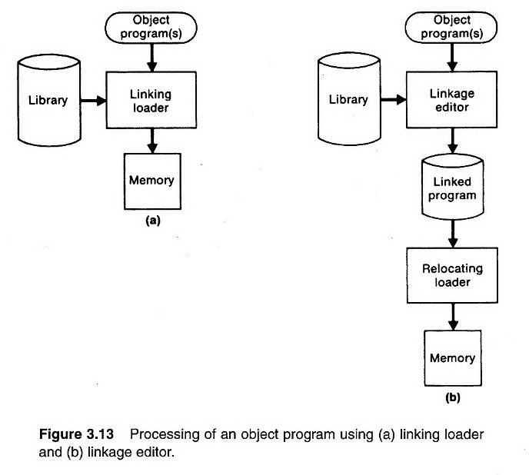
Linking Loader vs. Linkage Editor (1/2) (Fig. 3.13)

Slide 13
Linking Loader vs. Linkage Editors (2/2)
Comparison
  Linking Loader: performs all linking and relocation operations, including library search if specified, and loads the linked program directly into memory for execution
  Linkage Editors: produces a linked version of the program (often called a load module or an executable image), which is written onto a file or library for later execution
  Resolution of external reference and library searching are only performed once for linkage editor
    If a program is to be executed many times without being reassembled, the use of a linkage editor substantially reduces the overhead required.
    If a program is under development or is used infrequently, the use of a linking loader outperforms a linkage editor

Slide 14
Dynamic Linking (1/2)
Comparison
  Linkage editors perform linking operations before the program is loaded for execution
  Linking loaders perform linking operations at load time
  Dynamic linking (dynamic loading, load on call) perform linking at execution time
Delayed Binding
  Avoid the necessity of loading the entire library for each execution, i.e. load the routines only when they are needed
  Allow several executing programs to share one copy of a subroutine or library (Dynamic Link Library, DLL)

Slide 15
Dynamic Linking (2/2)
Via an OS
  Dynamic loader is one part of the OS
  Instead of executing a JSUB instruction that refers to an external symbol, the program makes a load-and-call service request to the OS
  Pass of control
    User program → OS
    OS: load the subroutine
    OS → Subroutine
    Subroutine → OS
    OS → User program

Slide 16
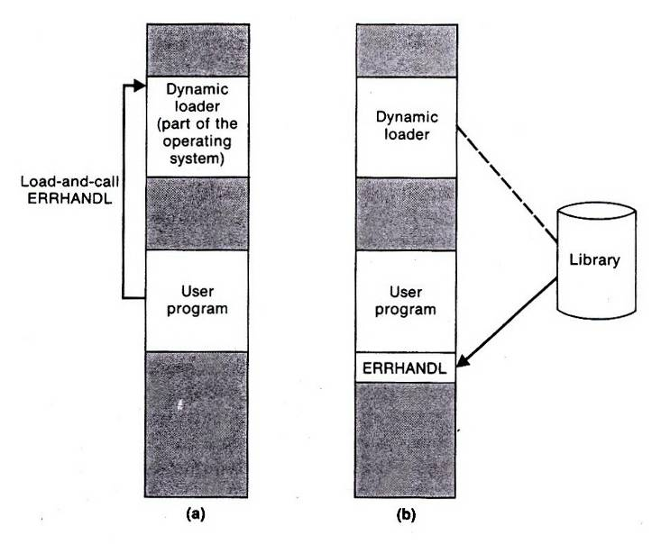
Fig. 3.14 (1/2)

Slide 17
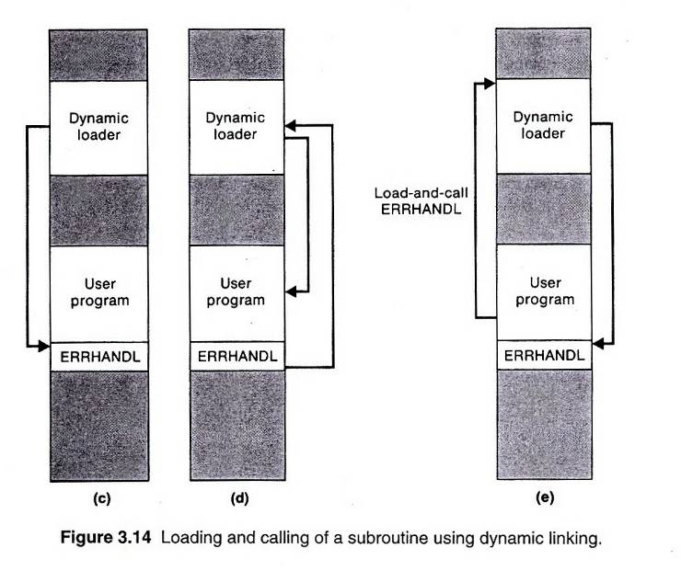
Fig. 3.14 (2/2)

Slide 18
Bootstrap Loaders
Absolute loader
  One some computers, an absolute loader program is permanently resident in a read-only memory ROM
  One some computers, there’s a built-in hardware which read a fixed-length record from some device into memory at a fixed location. After the read operation, control is automatically transferred to the address in memory

Slide 19
Implementation Example -- MS-DOS
MS-DOS assembler (MASM) produce object modules (.OBJ)
MS-DOS LINK is a linkage editor that combines one or more modules to produce a complete executable program (.EXE)
MS-DOS object module
  THEADER similar to Header record in SIC/XE
  MODEND similar to End record in SIC/XE

Slide 20
MS-DOS object module
  TYPDEF data type
  PUBDEF similar to Define record in SIC/XE
  EXTDEF similar to Reference record in SIC/XE
  LNAMES contain a list of segments and class names
  SEGDEF segment define
  GRPDEF specify how segments are grouped
  LEDATA similar to Text Record in SIC/XE
  LIDATA specify repeated instructions
  FIXUPP similar to Modification record in SIC/XE

Slide 21
Repeated Instruction
Suppose that the SIC assembler language is changed to include a new form of the RESB statement, such as
  RESB n‘c’
which reserves n bytes of memory and initializes all of these bytes to the character ‘c’. For example
BUFFER RESB 4096‘ ’
This feature could be implemented by simply generating the required number of bytes in Text records. However, this could lead to a large increase in the size of the object program.

Slide 22
LINK
Pass 1
  Compute a starting address for each segment in the program
    Segment from different object modules that have the same segment name and class are combined
    Segments with the same class, but different names are concatenated
    A segment’s starting address is updated as these combinations and concatenations are performed
Pass 2
  Extract the translated instructions from the object modules
  Build an image of the executable program in memory
  Write it to the executable (.EXE) file

Slide 23
SunOS Linkers
Link-editor
  Relocatable object module, for further link-editing
  Static executable, ready to run
  Dynamic executable, some symbolic references need to be bound at run time
  Shared object, services that can be bound at run time to dynamic executables
Run-time linker

Slide 24
Run-Time Linker
Locate and include necessary shared objects
Lazy binding
  Binding of procedure calls is normally deferred until the program is in execution
Reduce the amount of overhead required for starting a program

